Slide 1
Travel Buddy
Group project 2: Kaitlyn Adams, Evan Anderson, Laura Fiig, Frankie Nicko, and Jillian Striker

Slide 2
Summary
Demo
Github Workflow
Communication
Division of Labor
Troubleshooting
Shameless Self-congratulation
Stretch Goals
Questions

Slide 3
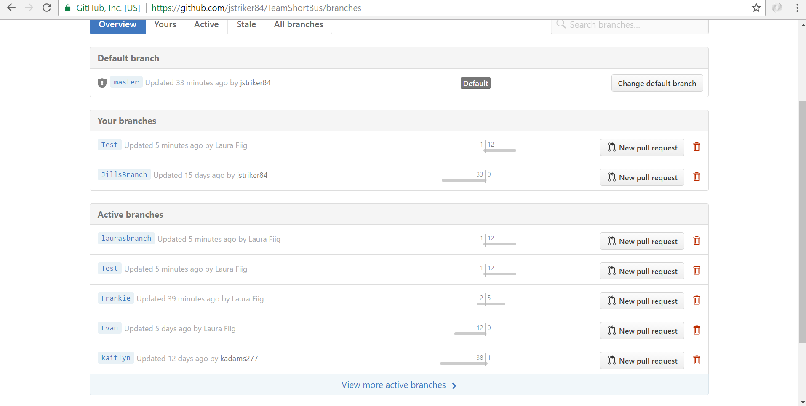
Github Workflow

Slide 4
Communication
Challenges:
Holiday travel
Solutions:
Github branches
Slack group chat
Division of labor

Slide 5
Division of Labor
Primarily Front-end:
Kaitlyn
Frankie
Primarily Back-end:
Evan
Laura
Jillian

Slide 6
Troubleshooting
Github
How to work within branches without messing up the Test branch
How to navigate between branches
How to resolve merging conflicts between branches and the Test branch
Order of operations
File structure was not set up until almost the end of the project
Deployment to Heroku
SQL database add-on tool issues

Slide 7
Shameless Self-congratulation
Division of Labor
Goal-setting within each group meeting
Each person left meeting with a task to complete
Setup and use of a Github Test branch
Communication within the group
Realistic project goals within the timeline

Slide 8
Stretch Goals
Add hotel and activity recommendations and reviews based on survey responses
Add flight data to display in survey response
Add ability for user to add or modify destinations to the database
Separate destination reviews from app reviews
Display destination reviews in survey response
Display app reviews at the bottom of the survey page

Slide 9
Questions?

